Slide 1
GoPubMed and biomedical question answering
Dirk Weissenborn, George Tsatsaronis,
Heiko Dietze Maria Kissa, Michael Alvers, Liliana Barrio-Alvers, Michael Schroeder
TU Dresden
Source pasch-net.de

Slide 3
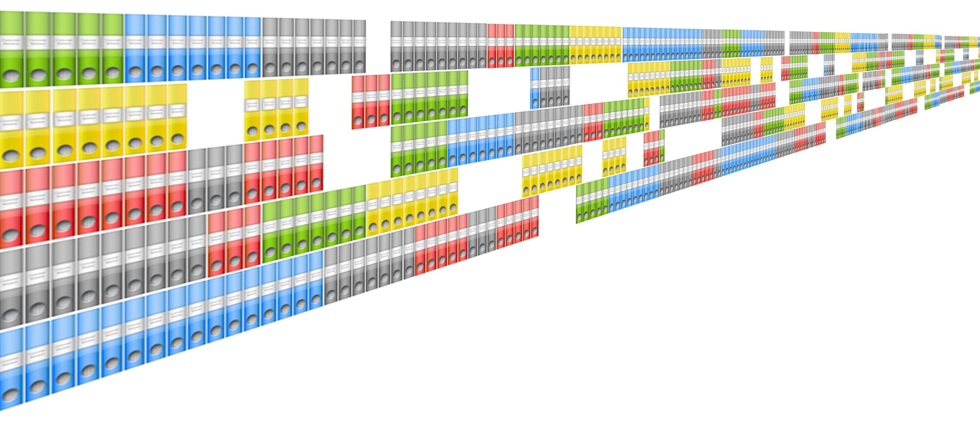
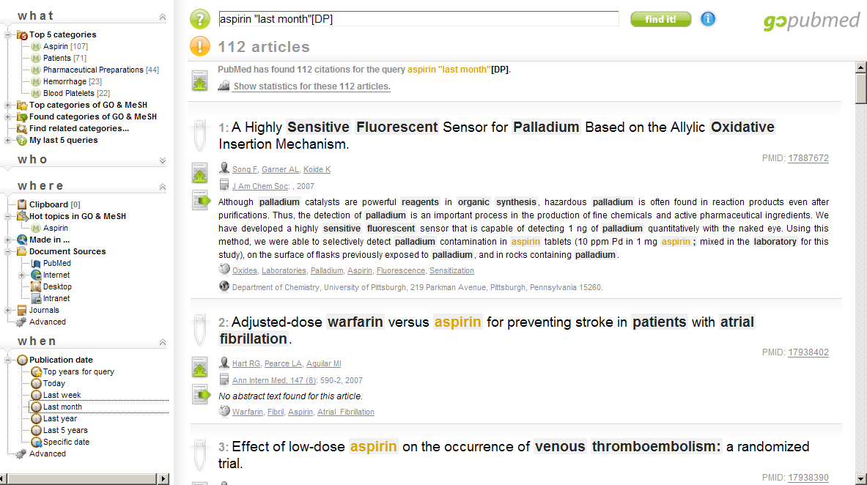
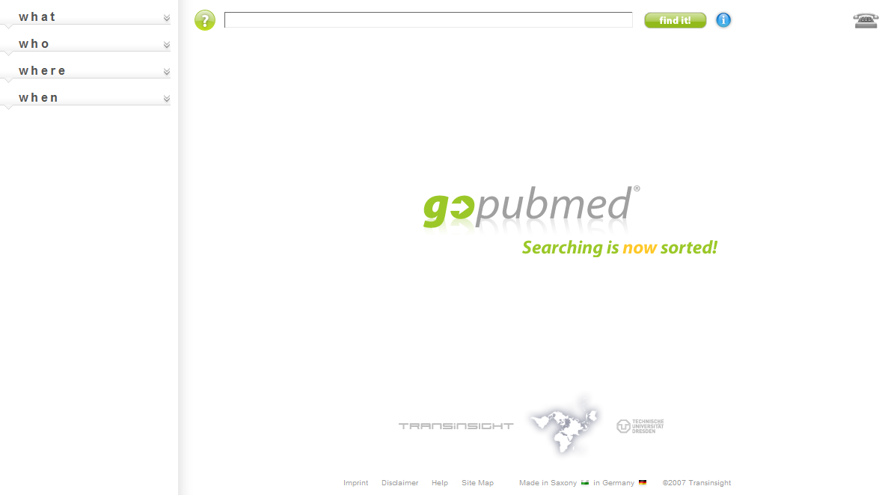
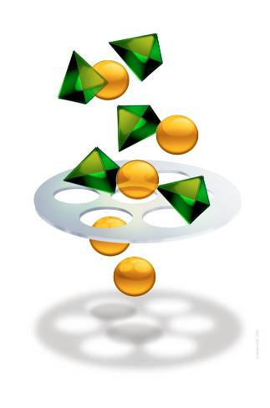
Searching is now Sorted!

Slide 4
Answering questions with GoPubMed/GoWeb Heiko Dietze

Slide 5
Gene and Function
Example:
Which functions does “Rag C” have?
Function: RNA splicing, transcription, GDP binding, cytoplasm
457 genes and 1352 ontology terms
Manually curated from full-text articles
BioCreAtIvE 1 (Task 2) Blaschke et al.
Recall: 58% (785 of 1352)
Query for gene name
Induced ontology contains the terms
Benchmark:
GoWeb:
Dietze et al. BMC Bioinformatics, 2009

Slide 6
Symptoms and Disease
Example:
Symptoms: fever, anterior mediastinal mass, and central necrosis
Disease: Lymphoma
26 diagnostic case records (New England Journal of Medicine)
15/26 (58%) symptoms as keywords, results manually curated
13/26 (50%) cases
20/26 (77%) cases correct answer
10 cases, answer directly in top categories
Implicit usage of full-text from the web
Benchmark:
Tang et al. Google:
GoPubMed:
GoWeb:
Dietze et al. BMC Bioinformatics, 2009

Slide 7
Proteins, Diseases, and Evidences
Example:
What is the role of MMS2 in cancer?
28 questions, TREC Genomics 2006
Passage retrieval for question answering
Biomedical literature, full-text
22 of 28 (78,6%) answer possible
Transform question to keywords
Find snippet with a valid answer
13 cases, semantic filter
Benchmark:
GoWeb:
Dietze et al. BMC Bioinformatics, 2009

Slide 8
Answering questions a BioASQ baseline Dirk Weissenborn and George Tsatsaronis

Slide 9
Baseline
UMLS: over 1000.000 concepts
PubMed: over 23 Mio. abstracts
PMC: over 800 0000 full text documents
MetaMap, Tokenized, POS, Dependency parsing, semantic role labelling, chunking,...

Slide 10
Baseline
Step 1: Question type
...more common in men or women?
Where in the cell is...?
Which medication...
Step 2: Document retrieval (keywords and expanded concepts)

Slide 11
Baseline
Step 3: Candidate generation
Prominence scoring:
Answer is frequent in docs
Answer is frequent in sentences similar to question
Type scoring:
Candidate matches question type
Specificity scoring:
TFIDF
Weighting of scores through logistic regression on mini benchmark
Step 4:
Factoid: Answer is highest scoring candidate
List: Answer are all above threshold

Slide 12
Baseline 6 out of 12 correct

Slide 13
Asking questions Maria Kissa

Slide 14
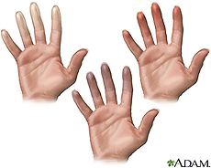
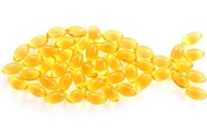
The cheapest clinical trial
Fact 1: Tiejen 1975: “patients with Raynaud’s syndrome… increased blood viscosity”
Fact 2: Woodcock 1984: “Beneficial effect of fish oil on blood viscosity”

Slide 15
The cheapest clinical trial
Fact 1: Tiejen 1975: “patients with Raynaud’s syndrome… increased blood viscosity”
Fact 2: Woodcock 1984: “Beneficial effect of fish oil on blood viscosity”
Hypothesis = Fact 1 + Fact 2: Swanson 1986 Fish oil as treatment of Raynaud’s syndrome
Valdidation: DiGiacomo 1989

Slide 16
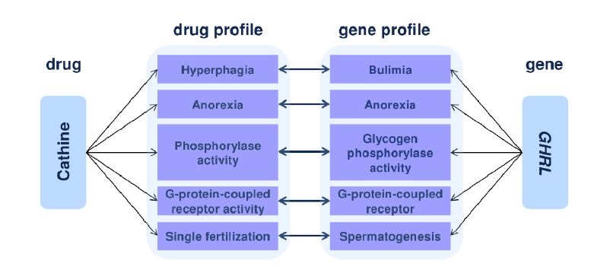
Drug-target prediction by side effect similarity

Slide 17
Conclusions
GoPubMed answers questions interactively
GoPubMed helps asking questions
User, user, user
Mine user behaviour
For whom? Which goal?
What is interestingness?
Explain at the right level
Data, data, data
Ontologies: How to trade-off automation quality and use
Ambiguity is not the main problem

Slide 18
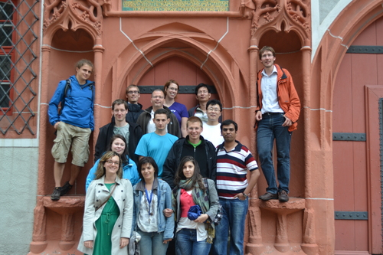
Acknowledgements
Funding: DFG, EU, BMBF, BMWi

Slide 19
Entity recognition
Is it a „defined“ entity, e.g. gene with function, chromosomal location, etc.?
Is it a mere string, e.g. ontology term?
Is there training data?

Slide 20
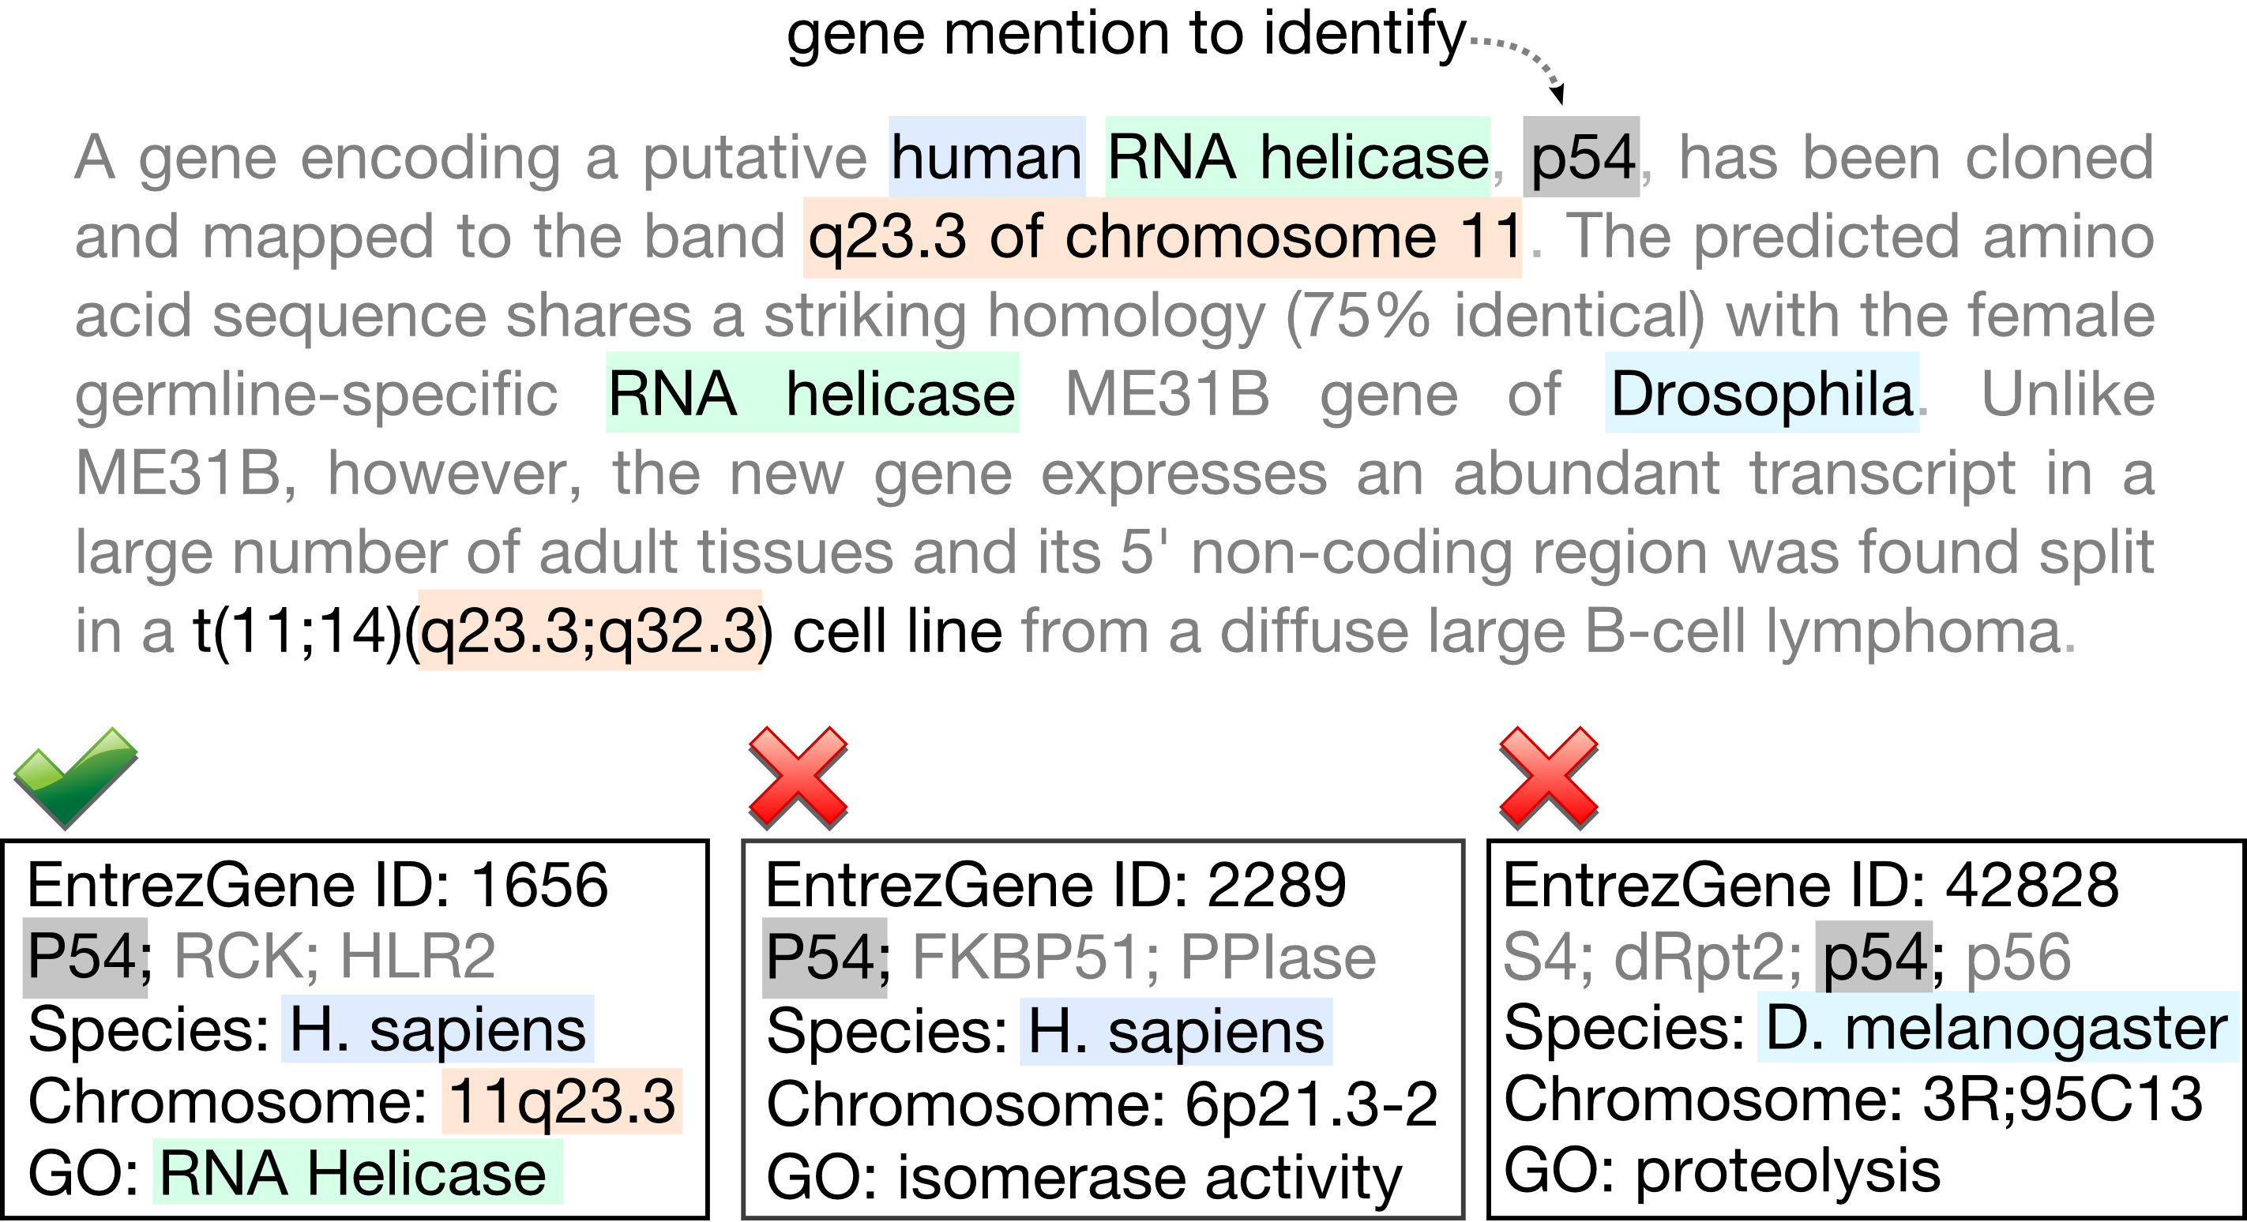
Gene mention identification
Best result at BioCreative II, current F-measure: 86%
Gene mention normalization and interaction extraction with context models and sentence motifs
Hakenberg, Plake, Royer, Strobelt, Leser and Schroeder. Genome Biology 2008.

Slide 21
Ambiguity
On a sample of almost 4,000 MeSH terms
7% ambiguous terms according to WordNet
6% ambiguous terms according to Wiki
18% ambiguous terms according to UMLS
Tsatsaronis et al. Biomedical Semantics, 2012

Slide 22
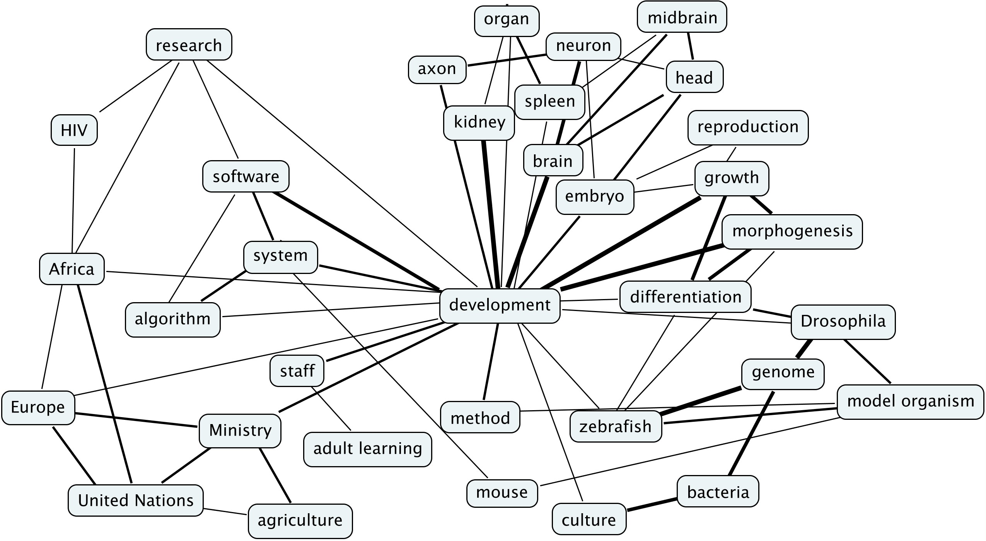
Tell me thy company, and I'll tell thee what thou art. Miguel de Cervantes (1547-1616)
That‘s why machine learning works!

Slide 23
80% x 80% x 80% = 50%
Relationships

Slide 24
Patterns from Multiple Sequence Alignment
60% F-score (no gene identification)
Hakenberg et al. Genome Biology, 2008

Slide 25
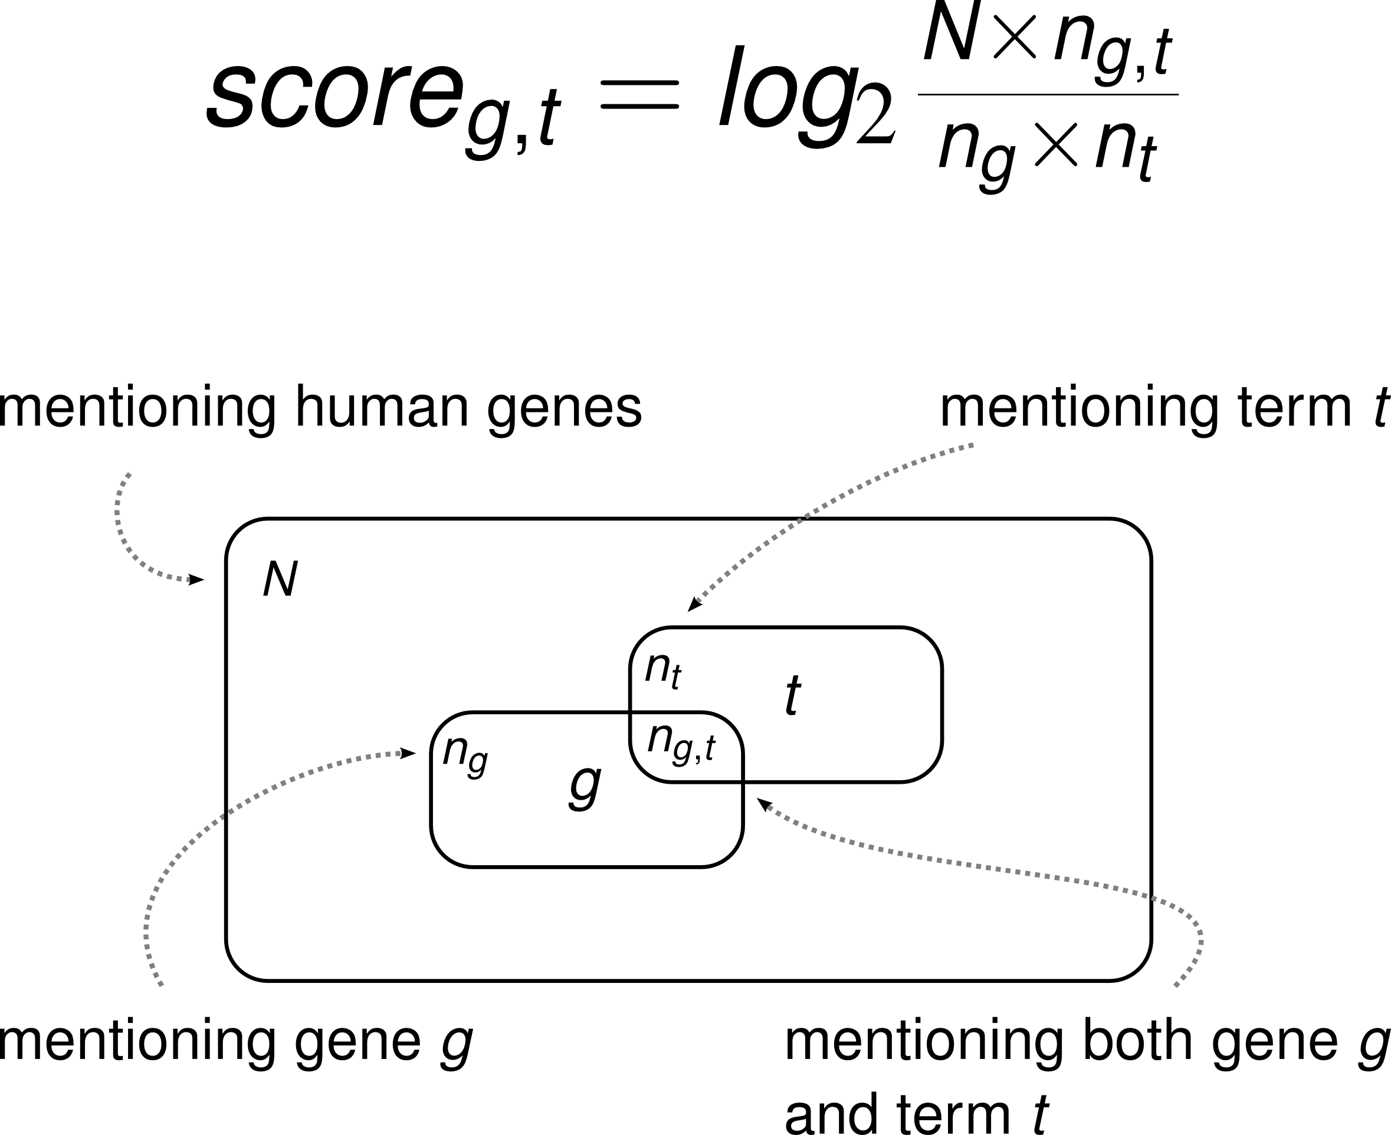
Significant co-occurrences
Notes:
Mutual information

