Slide 1
NLM Medical Text Indexer (MTI) BioASQ Challenge Workshop September 27, 2013
J.G. Mork, A. Jimeno Yepes, A. R. Aronson

Slide 2
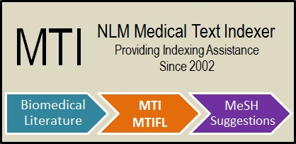
Disclaimer
The views and opinions expressed do not necessarily state or reflect those of the U.S. Government, and they may not be used for advertising or product endorsement purposes.

Slide 3
Outline
MTI
Overview
Description
Performance
Future Work
Questions

Slide 4
MTI - Overview
Summarizes input text into an ordered list of MeSH Headings
In use since mid-2002 (Indexers, Cataloging, HMD)
MTI as First-Line Indexer (MTIFL) since February 2011
Developed with continued Index Section collaboration
Uses article Title and Abstract
Provides recommendations for 93% of indexed articles (2012)
The weathervane. (23463855)
Before 911... (23465427)
The in-betweeners. (23348431)
Valete, salvete. (23143314)

Slide 5
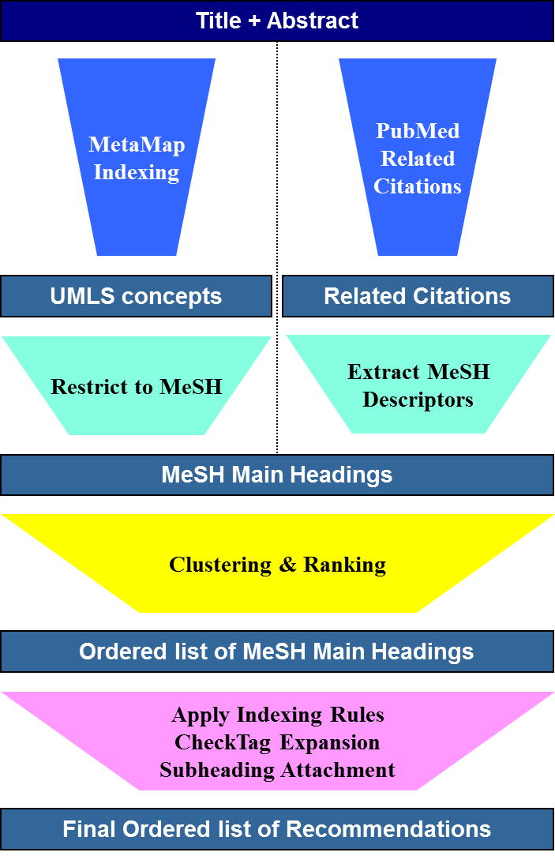
MTI
MetaMap Indexing Actually found in text
Restrict to MeSH Maps UMLS Concepts to MeSH
PubMed Related Citations Not necessarily found in text

Slide 6
Unified Medical Language System (UMLS)
Large multi-lingual biomedical vocabulary database
UMLS Metathesaurus (currently using 2012AB)
MetaMap Indexing uses a subset:
Only requires UMLS license and for use with US-based projects
2,461,504 concepts with 7,685,881 entries
English Only
75 of the 168 Source Vocabularies
Changes twice a year

Slide 7
MetaMap Indexing (MMI)
Used for finding UMLS concepts actually in the text.
Better coverage versus just looking for MeSH Headings
Provides our best indicator of MeSH Headings
Handles spelling variants, abbreviations, and synonym identification. (Handles most British Spellings)
Obstructive Sleep Apnea
Obstructive Sleep Apnoea
OSA (3-ways ambiguous)
* Heart Attack
* Myocardial Infarction

Slide 8
Restrict to MeSH
Encephalitis Virus, California
ET: Jamestown Canyon virus
ET: Tahyna virus
Inkoo virus
Jerry Slough virus
Keystone virus
Melao virus
San Angelo virus
Serra do Navio virus
Snowshoe hare virus
Trivittatus virus
Lumbo virus
South River virus
ET: California Group Viruses
Allows us to map UMLS concepts to MeSH Headings
Updated with each UMLS release
Extends MMI abilities by mapping nomenclature to MeSH

Slide 9
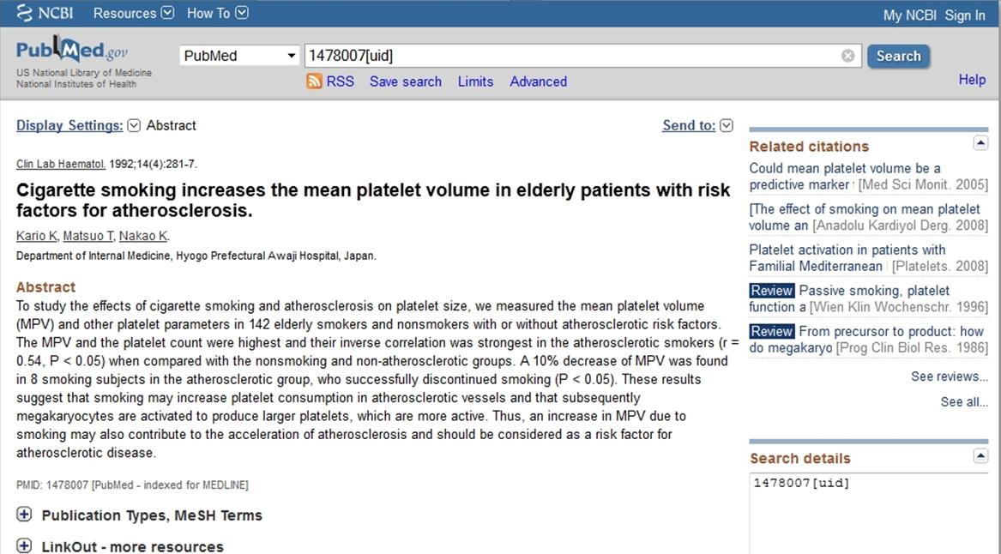
PubMed Related Citations

Slide 10
PubMed Related Citations (PRC)
Uses PubMed pre-calculated related articles
Only use MeSH Headings, no Check Tags, no Subheadings, no Supplementary Concepts
Provides terms not available in title/abstract
Used to filter and support MeSH Headings identified by MetaMap Indexing
Can provide non-related terms, so heavily filtered

Slide 11
Special Handling
Forcing Recommendations
New MeSH Headings (first 6 – 12 months)
Correct: 66.96% (2,935 / 4,383)
“B” (Organisms) and “D” (Chemicals and Drugs) in title
Correct: 69.90% (77,882 / 111,416)
Most MeSH Headings and Supplementary Concepts in title
Correct: 81.18% (377,571 /465,128)

Slide 12
Special Handling
Forcing Recommendations (continued)
Check Tag Triggers (~3,000 + 770 Tree Rules)
“fetal heart rate” ➔ Female and Pregnancy
Correct: 81.69% (885,092 / 1,083,457)
496 Triggers – all from Indexer Feedback
“saxs” ➔ X-Ray Diffraction + Scattering, Small Angle
Correct: 65.07% (73,692 / 113,257)

Slide 13
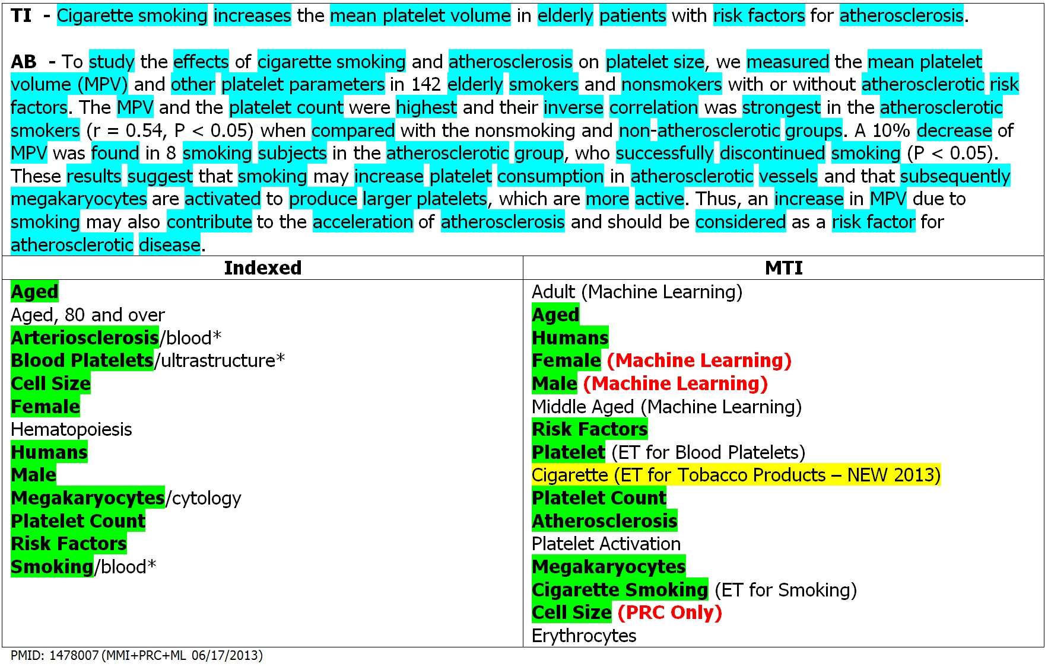
MTI Example

Slide 14
MTI as First Line Indexer (MTIFL)
89 Journals currently in MTIFL program – 327 by end of 2015
MTI & MTIFL philosophically different
Almost 30 rules/heuristics used
Special Filtering using MMI & PRC against each other
MMI tends to provide more general terms
PRC tends to provide more specific terms (or terms not related)
Smaller more accurate list of terms than MTI
Heuristic #6: MMI Only Term
If both MMI & PRC recommend a more specific term, remove the term.
Heuristic #7: PRC Only Term
If MMI does not have a more general term related, remove the term.

Slide 15
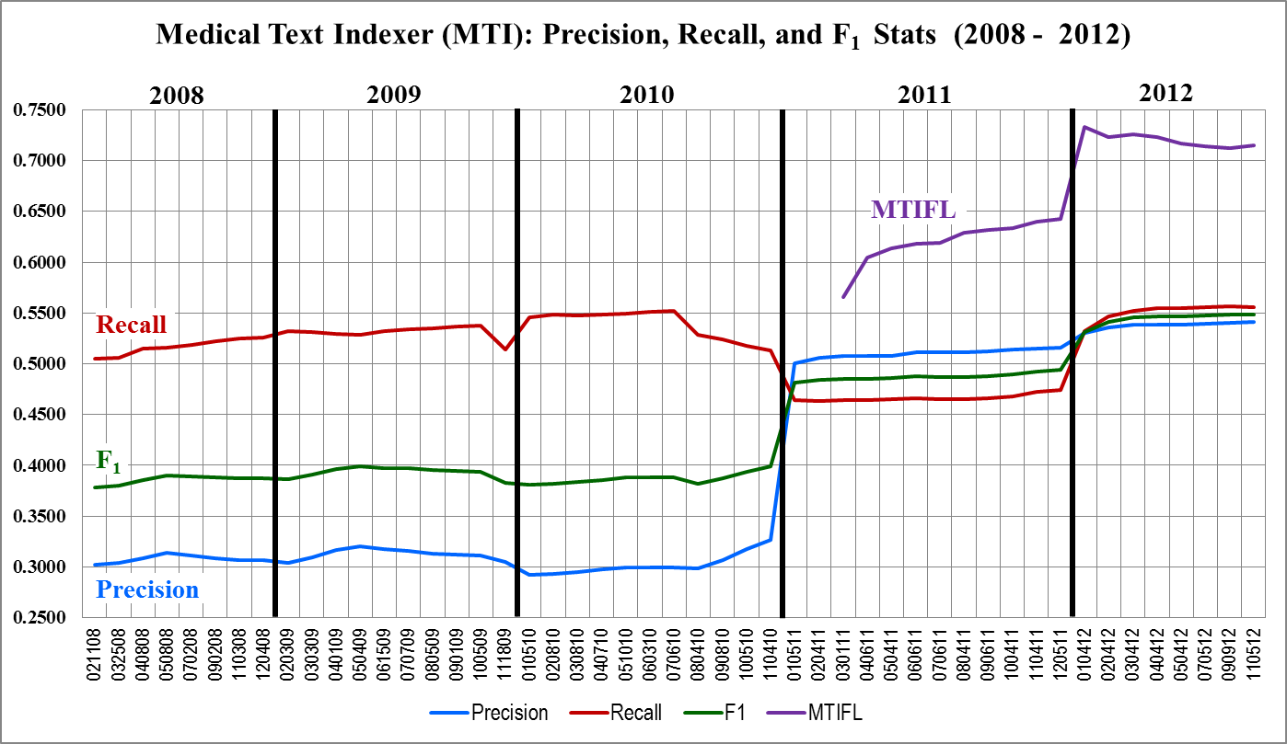
Performance
Fruition of 2011 Changes
Focus on Precision versus Recall

Slide 16
Future Work
Structured Abstracts
Full Text
Author Supplied Keywords
Improving Subheading Attachment
Expanding MTIFL Program
Assisting on Gene and Chemical Identification Projects
Recommending some Publication Types
Species Detection and Filtering

Slide 17
Questions?
MTI Team Members:
Alan (Lan) R. Aronson: alan@nlm.nih.gov
James G. Mork: mork@nlm.nih.gov
Antonio J. Jimeno Yepes: antonio.jimeno@gmail.com
Web Site:
http://ii.nlm.nih.gov

Slide 18
Extensible
Same program, five levels of filtering, customized output
All Processing – Base Filtering
Indexing – High Recall Filtering
Cataloging – High Recall Filtering
History of Medicine – High Recall Filtering
MTIFL – Balanced Recall/Precision Filtering
Strict – High Precision Filtering (not currently used)
Ability to Turn Off All Filtering (used in experiments)
❶
❷
❸
❹
❺

Slide 19
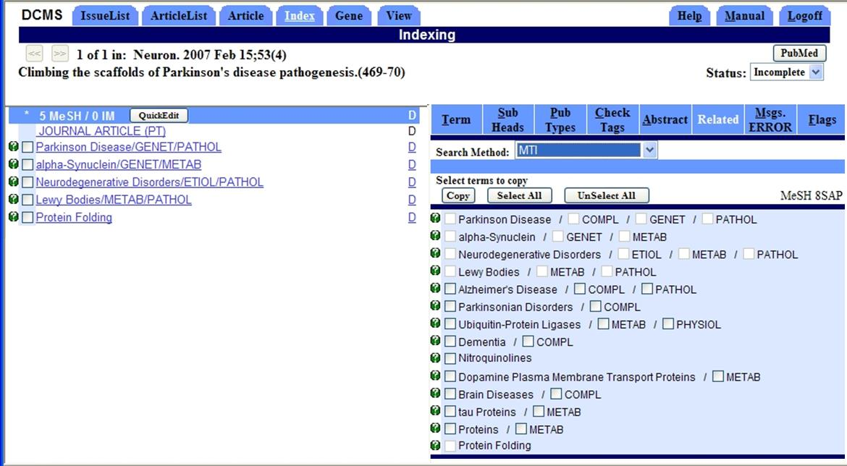
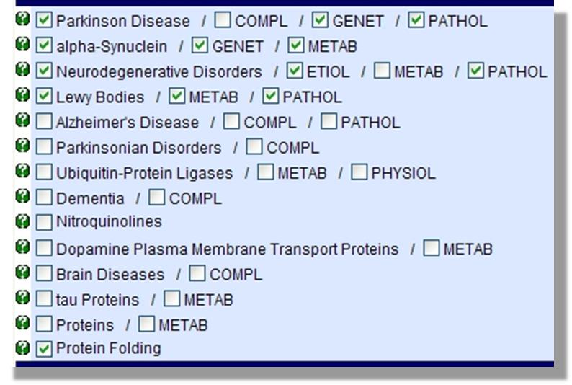
Data Creation & Management System (DCMS)

Slide 20
Challenges
MTI Currently Not Able to Differentiate:
Species specific terms
BIRC3 protein, human
Birc3 protein, mouse
Birc3 protein, rat
Concepts where words are separated by text
“Lon is an oligomeric ATP-dependent protease” in text should recommend Lon Protease (ET for Protease La)

Slide 21
Performance
Current YTD (November 2012 – August 2013)
Percentage Right (Precision)
 | MTI | MTIFL
Citations | 539,157 | 6,846
MMI Only | 69.18% / 1,313,077 | 76.61% / 11,536
PRC Only | 42.98% / 509,775 | 80.03% / 3,839
MMI+PRC | 54.93% / 1,837,432 | 72.04% / 30,075
Overall | 56.93% | 73.78%

