Slide 1
Indexing the Biomedical Literature in a Time of Increased Demand and Limited Resources BioASQ Workshop September 27, 2013
Alan R. Aronson
Lister Hill Center, US National Library of Medicine
alan@nlm.nih.gov

Slide 2
The NLM Indexing Initiative Team
Alan R. Aronson
James G. Mork
François-Michel Lang
Willie J. Rogers
Antonio J. Jimeno-Yepes
J. Caitlin Sticco
The views and opinions expressed do not necessarily state or reflect those of the U.S. Government, and they may not be used for advertising or product endorsement purposes.

Slide 3
Outline
MEDLINE Indexing
Indexing Initiative
Medical Text Indexer (MTI)
MTI as First-Line Indexer (MTIFL)
MetaMap
Gene Indexing Assistant (GIA)
Machine Learning Improvements
Future Work

Slide 4
MEDLINE Citation Example

Slide 5
Chemical Flag Example
Chemical Flags for PMID: 23937051
1-(4-Cl-benzyl)-3-Cl-4-(CF3-phenylamino)-1H-pyrrol-2,5-dione (MI-1)|Structure on page 75.
5-amino-4-(1,3-benzothiazol-2-yl)-1-(3-methoxyphenyl)-1,2-dihydro-3H-pyrrol-3-one (D1)|Structure on page 75.

Slide 6
Gene Indexing Example
These results demonstrate that FLNA is prone to pathogenic rearrangements
Notes:
When an indexer is indexing a paper, if that paper is focused on a gene or gene product, they create what’s called a GeneRIF. You can see some examples of geneRIFs here. We’re looking at a record in the NCBI Gene database for (click) Filamin A alpha. (click) If you scroll down to the middle of the record, you find a section containing the geneRIFs for that gene. (click) A geneRIF is a link in an Entrez Gene record back to the original paper, with a short annotation summarizing the paper’s findings about that gene or protein. Usually that annotation is something derived from the abstract.
So to make these, the indexer has to manually match the genes in the paper to the Entrez Gene record, make that link, and create an annotation. This process is labor intensive and expensive—about $4.90 per article.

Slide 7
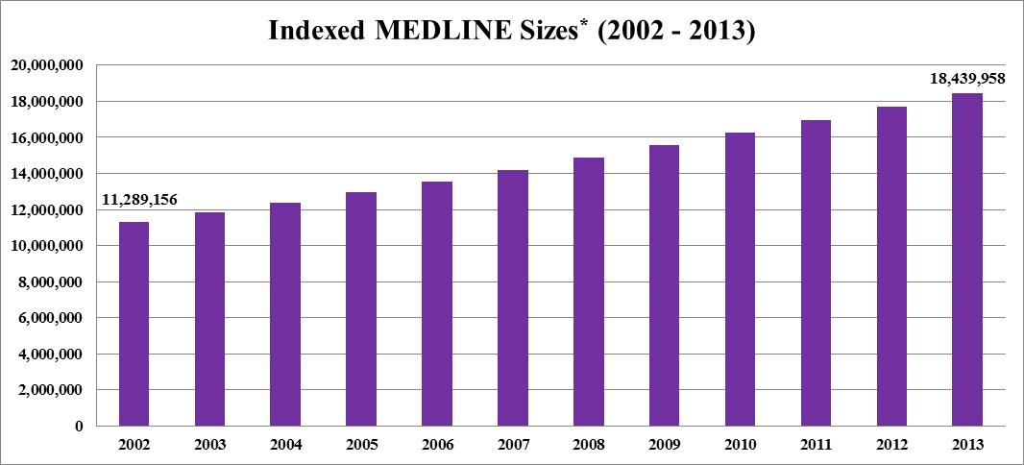
Growth in MEDLINE
* MEDLINE Baseline less OLDMEDLINE and PubMed-not-MEDLINE

Slide 8
Costs of Doing Business
~$9.40 to index an article
~$4.90 to add a GeneRIF
~$9.40 to add a Chemical Flag
Quickly approaching 1,000,000 articles indexed per year

Slide 9
Indexing Demand vs. Budgets
Demand for indexing continues to grow
Budgets were flat in the mid-1990s
The NIH budget almost doubled in five years: 1999-2003
Current budgets are flat or declining

Slide 10
Outline
MEDLINE Indexing
Indexing Initiative
Medical Text Indexer (MTI)
MTI as First-Line Indexer (MTIFL)
MetaMap
Gene Indexing Assistant (GIA)
Machine Learning Improvements
Future Work

Slide 11
The NLM Indexing Initiative
The need for MEDLINE indexing support from the 1990s:
Increasing demand/costs for indexing in light of
Flat budgets
In response, NLM initiated the Indexing Initiative in 1996 to study ways of meeting the perceived need
Cross-library and cross-discipline team assembled
A prototype indexing system matured into the Medical Text Indexer (MTI)

Slide 12
MEDLINE Indexing Resources
Medical Subject Headings (MeSH)
Biomedical indexing vocabulary maintained by NLM
Main headings, subheadings, supplementary concepts
Unified Medical Language System (UMLS) Metathesaurus
A thesaurus constructed from the terms in over 150 vocabularies one of which is MeSH
Synonymous terms are grouped into concepts (~3M) and assigned semantic types (133)
Relationships among concepts are inherited from term sources or assigned by UMLS editors

Slide 13
MTI - Overview
Summarizes input text into an ordered list of MeSH Headings
Assisted indexing of Index Section journal articles since 2002
Assisted indexing of Cataloging and History of Medicine Division records
Automatic indexing of NLM Gateway meeting abstracts (2002 – 2012)
First-line indexing (MTIFL) since February 2011
Also available to the Community
45,672 requests; 16,074,511 items processed (2012)
MTI reduces cost and lets indexers focus on tasks requiring human judgement
Notes:
Highlight Index Section support
MTIFL
NLM Gateway now gone away

Slide 14
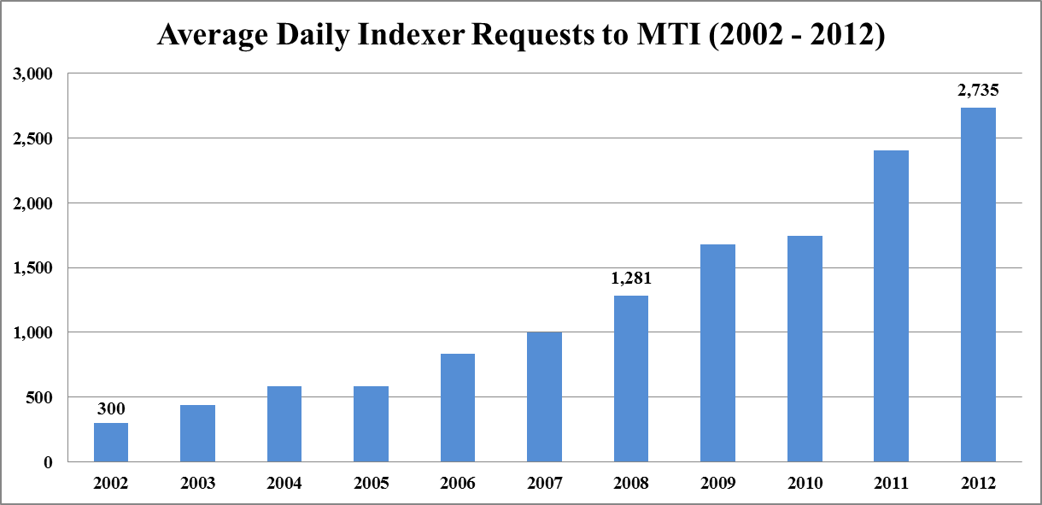
MTI Usage

Slide 15
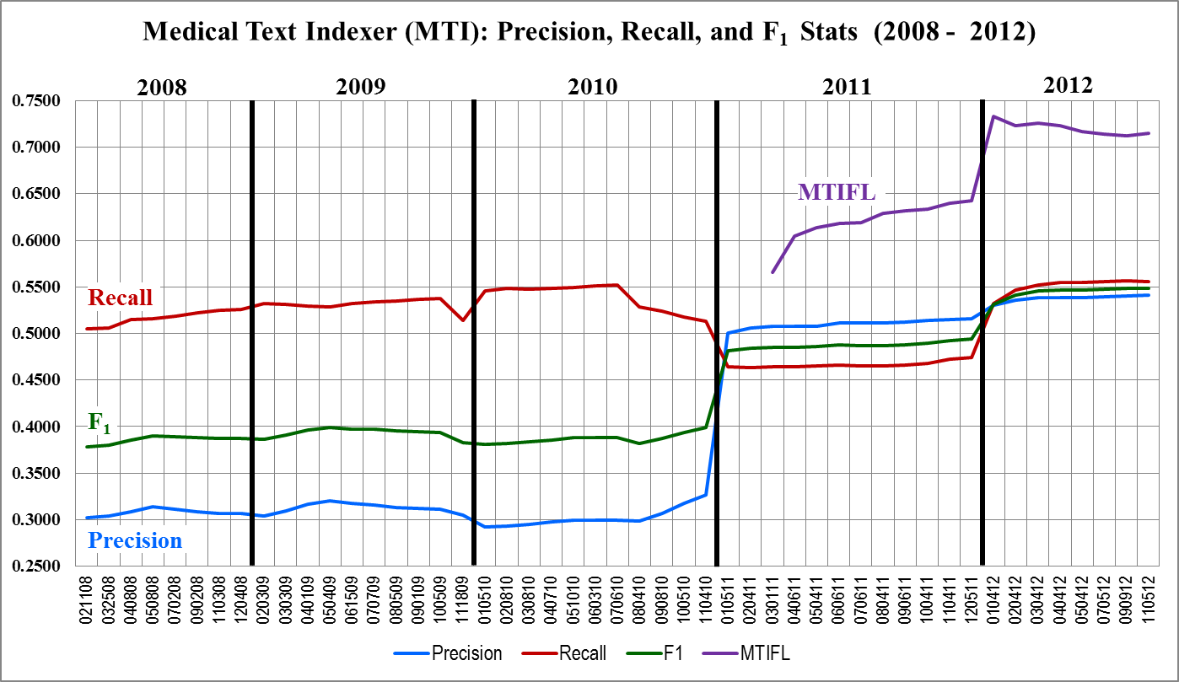
MTI - How are we doing?

Slide 16
MTI as First-Line Indexer (MTIFL)
First experiments conducted 2010
Focused on journals MTI performed extremely well on
Involved multiple experiments with Indexers
Timing information provided critical evaluation criteria
Moved into Production February 2011
Started with 14 journals
Now have 89 journals for approximately 10,000 articles/year
Expected to expand to 372 journals by end of 2015
Notes:
No or limited GeneRIFs
No or limited Chemical Flags
Higher precision for MTIFL since it took longer to remove wrong then to add missed

Slide 17
MTI as First-Line Indexer (MTIFL)
Indexing Displays in PubMed as Usual
Indexing Displays in PubMed as Usual
MTI
Processes/
Recommends MeSH
Reviser
Reviews
Selects
Adjusts
Approves
MTI
Processes/
Recommends MeSH
Reviser
Reviews
Selects
Adjusts
Approves
89 MEDLINE Journals
Indexer
Reviews
Selects
Indexer
Reviews
Selects
“Normal”
MTI Processing
Notes:
Small percentage of journals capable of MTIFL
Never fully replace Indexers – this allows MTI to handle the “easy” indexing
Freeing Indexers up to handle more complex and interesting articles.
Susan Roy – Library Associate Fellow

Slide 18
MTI as First-Line Indexer (MTIFL)
Indexing Displays in PubMed as Usual
Indexing Displays in PubMed as Usual
MTI
Processes/
Indexes MeSH
Reviser
Reviews
Selects
Adjusts
Approves
MTI
Processes/
Indexes MeSH
Reviser
Reviews
Selects
Adjusts
Approves
89 MEDLINE Journals
Index Section
Compares MTI and Reviser Indexing
Indexer
Reviews
Selects
MTIFL
MTI Processing
Notes:
Small percentage of journals capable of MTIFL
Never fully replace Indexers – this allows MTI to handle the “easy” indexing
Freeing Indexers up to handle more complex and interesting articles.
Susan Roy – Library Associate Fellow

Slide 19
MTIFL: What We Know So Far
MTIFL precision is higher than non-MTIFL (73% vs 57%)
Accepted MeSH terms indexed by MTIFL tend to be suggested by both MetaMap and PubMed Related Citations.
Removed MeSH terms indexed by MTIFL tend to be more general than what the indexer chooses (typically one tree level).
MTIFL indexing is faster than non-MTIFL indexing
Removing incorrect terms takes longer than adding missing terms
On average:
indexers remove 2.4 incorrect terms
indexers add 3.8 missing terms
MTIFL misses only 1 major term

Slide 20
MetaMap
Named-entity recognition
Identify UMLS Metathesaurus concepts in text
Important and difficult problem
MetaMap’s dual role:
Local: Critical component of NLM’s Medical Text Indexer (MTI)
Global: Biomedical concept-identification application

Slide 21
The Gene Indexing Assistant
An automated tool to assist the indexer in identifying and creating GeneRIFs
Evaluate the article
Identify genes
Make links to Entrez Gene
Suggest GeneRIF annotation
Anticipated Benefits:
Increase in speed
Increase in comprehensiveness
Notes:
We have developed a production tool for partially automating gene indexing through both in house development and leveraging existing software. We call this tool the Gene Indexing Assistant or the G.I.A. The GIA will perform many of the tasks manually conducted by indexers:
-evaluate whether an article is likely to be suitable for gene indexing AND
-identify genes in the article.
-It will then create links based on those genes to the correct Entrez Gene records, AND
Hopefully eventually suggest candidate sentences for GeneRIF annotations.
-The indexer will then decide whether to keep, discard, or modify the links and suggestions.
When we text this tool with indexers this month, we hope to see gains in speed of indexing and the number of articles that receive gene indexing.

Slide 22
Machine Learning Improvements
Word Sense Disambiguation (WSD)
Knowledge-based
Corpus method, including creation of a new WSD TC
MTI Meta learning
Check tags
Gene indexing
Automatic summarization
Publication types

Slide 23
Outline
MEDLINE Indexing
Indexing Initiative
Medical Text Indexer (MTI)
MTI as First-Line Indexer (MTIFL)
MetaMap
Gene Indexing Assistant (GIA)
Machine Learning Improvements
Future Work

Slide 24
Future Work
Continued collaboration with the NLM Index Section
Planned improvements to MetaMap and MTI such as
Expansion/improvement of MTIFL capability
Add species detection to MTI for disambiguation and for GIA
Further MTI research with Antonio Jimeno-Yepes and Caitlin Sticco
Incorporation of strategies used by BioASQ participants

Slide 25
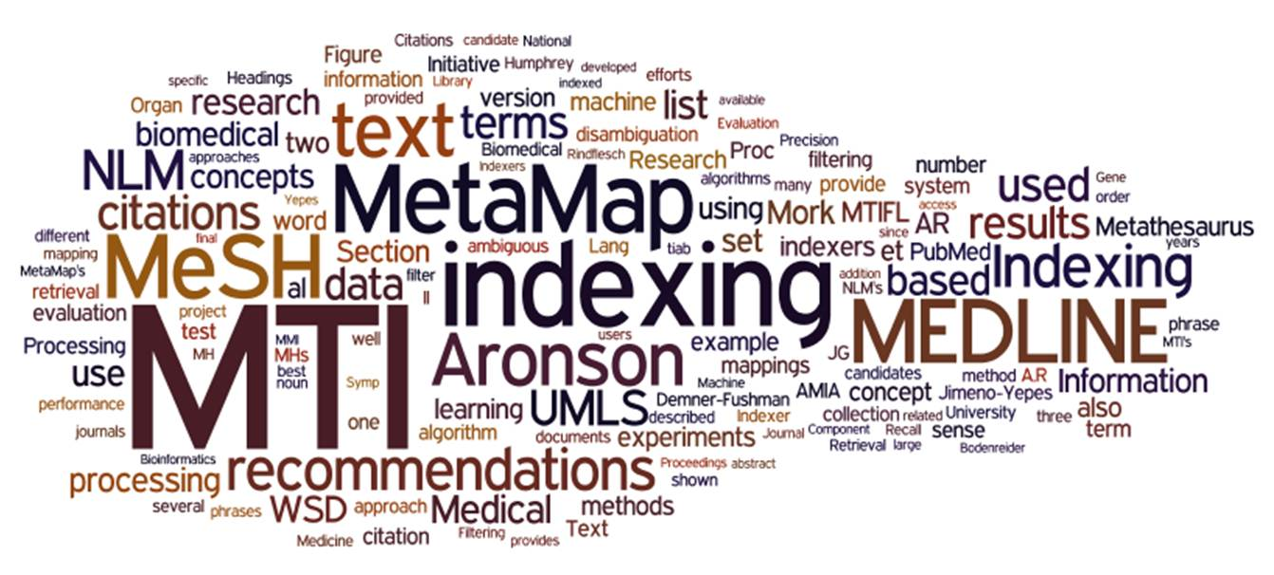
Questions
Generated using Wordle™ (www.wordle.net)
Alan (Lan) R. Aronson Willie J. Rogers
James G. Mork Antonio J. Jimeno-Yepes
François-Michel Lang J. Caitlin Sticco

