Slide 1
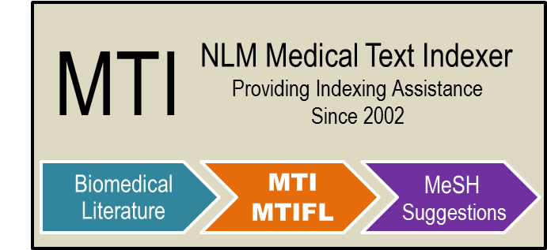
Recent Enhancements to the NLM Medical Text Indexer
BioASQ Challenge Workshop
September 16, 2014
J. Mork, D. Demner-Fushman,
S. Schmidt, A. Aronson

Slide 2
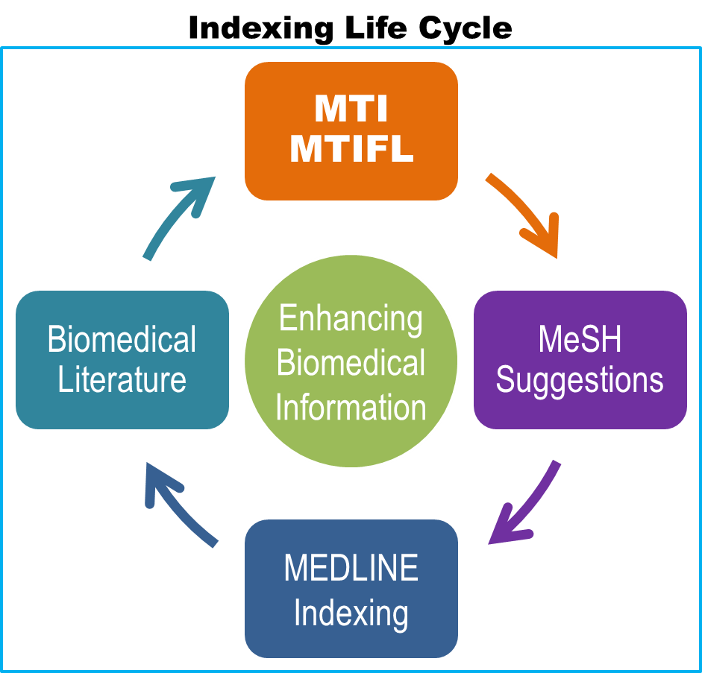
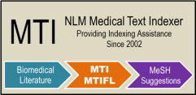
Disclaimer
Disclaimer
Outline
Overview of MTI
Vocabulary Density
Ambiguity and Filtering
Results
Future Work
Questions
The views and opinions expressed do not necessarily state or reflect those of the U.S. Government, and they may not be used for advertising or product endorsement purposes.

Slide 3
Outline
Disclaimer
Outline
Overview of MTI
Vocabulary Density
Ambiguity and Filtering
Results
Future Work
Questions
Overview of MTI
Vocabulary Density Analysis
Ambiguity and Filtering
Results
Future Work

Slide 4
Overview of MTI
Disclaimer
Outline
Overview of MTI
Vocabulary Density
Ambiguity and Filtering
Results
Future Work
Questions
Uses article Title and Abstract
Uses MetaMap and PubMed Related Citations
Summarizes input text into an ordered list of MeSH Headings
In use since mid-2002
MTI as First-Line Indexer (MTIFL) since February 2011
Developed with continued Index Section collaboration
Provides recommendations for 93% of indexed articles
Indexers consult MTI Recommendations for 64% of articles

Slide 5
Vocabulary Density Analysis
Disclaimer
Outline
Overview of MTI
Vocabulary Density
Ambiguity and Filtering
Results
Future Work
Questions
Partly inspired by Tsoumakas G, et al. Large-scale semantic indexing of biomedical publications at BioASQ.
Calculated Vocabulary Density Factor for each Journal and MeSH Heading combination used in the last five years.
Factor = Freq of MeSH Heading / Number of Citations
Preliminary Discoveries:
Journals used on average 999/27,149 (3.68%) MeSH Headings
83.81% of used MeSH Headings only found in 500 or fewer Journals
271 MeSH Headings are only found in a single Journal
Notes:
Note that we did ignore some special cases like Reviews, Comments, Retractions, etc.

Slide 6
Using Vocabulary Density
Disclaimer
Outline
Overview of MTI
Vocabulary Density
Ambiguity and Filtering
Results
Future Work
Questions
Amazed at the improvement from our first simple tests of the Vocabulary Density data.
Five Simple Rules:
Journal had to have at least 80 completed articles in the five years Provide a basic confidence level in the list of MeSH Headings
If MeSH Heading is new, don’t remove No historical basis to judge any new MeSH Heading
If Journal/MeSH Heading found in data, keep, otherwise remove
Factor > 0.74 for Journal/MeSH Heading, add if not already in list Based on a few quick runs of our test collection
Factor 1.0 for Journal/Check Tag, add if not already in list Based on quick runs with test collection and finding 0.9999 recommendations that were incorrect.
Check Tags: A special type of MeSH Heading that is required to be included for each article and cover species, sex, human age groups, historical periods, pregnancy, and various types of research support (e.g., Female, Mice, Adult).
Notes:
Explain differences between normal MHs and CTs
Explain “add to recommendations” means to add a term to the list of recommendations that was not found by MMI or PRC

Slide 7
Ambiguity and Filtering
Disclaimer
Outline
Overview of MTI
Vocabulary Density
Ambiguity and Filtering
Results
Future Work
Questions
30 MeSH Terms with “(Psychology)”
most are ambiguous terms with very specific meanings in MeSH:
Conditioning (Psychology)
Conflict (Psychology)
Denial (Psychology)
Dependency (Psychology)
Discrimination (Psychology)
Displacement (Psychology)
Generalization (Psychology)
Handling (Psychology)
Identification (Psychology)
Inhibition (Psychology)
Power (Psychology)
Practice (Psychology)
Regression (Psychology)
Reinforcement (Psychology)
Rejection (Psychology)
Retention (Psychology)
Set (Psychology)
Transfer (Psychology)
Recognition (Psychology)
Out of the Ballpark (OOTB) Terms
3-arm clinical trial ➔ Arm
Ambiguity biggest problem
Metaphorical ambiguity: Birds of a Feather Working Group ➔Birds & Feathers
Brand Name Ambiguity: commit murder ➔ Tobacco Use Cessation Products
Psychology Term Ambiguity: employee retention ➔ Retention (Psychology)

Slide 8
Ambiguity and Filtering
Disclaimer
Outline
Overview of MTI
Vocabulary Density
Ambiguity and Filtering
Results
Future Work
Questions
Body Part/Disease Tree Filtering
Title: “Review of Liver ailments” ➔ Liver
Abstract discusses Cirrhosis of the Liver, Liver Cancer, Hepatitis, etc.
Indexer groups together using: Liver Diseases
Different trees, hence OOTB status
Liver (A03.620)
Liver Diseases (C06.552)
Difficult to identify initial causes
Identified 37 types of these and set up rules
Majority of OOTB fall into this category
Not as bad of an error as the 3-arm clinical trial ➔ Arm
Notes:
Not as bad from the indexer’s stand-point!

Slide 9
Results
Disclaimer
Outline
Overview of MTI
Vocabulary Density
Ambiguity and Filtering
Results
Future Work
Questions
Vocabulary Density
2.69 (4.44%) improvement in Precision
0.05 (0.08%) improvement in Recall
1.36 (2.23%) improvement in F₁
Ambiguity Clean-Up and Filtering
Removed 3,175 (10.92%) OOTB Terms
Very slight dip in Recall (0.94)

Slide 10
Future Work
Disclaimer
Outline
Overview of MTI
Vocabulary Density
Ambiguity and Filtering
Results
Future Work
Questions
Expanded use of Machine Learning
Evaluating a Learning to Rank approach
Evaluating a complete Machine Learning approach
Vocabulary Density for Subheading Recommendations
Seeing up to 42.39 (97.77%) improvement in Precision
Overall improvement of 12.08 (21.25%) in Precision
Overall loss of 14.22 (41.99%) in Recall
Continue Expanding MTIFL Program

Slide 11
Questions?
Disclaimer
Outline
Overview of MTI
Vocabulary Density
Ambiguity and Filtering
Results
Future Work
Questions
MTI Team Members:
Alan (Lan) R. Aronson: alaronson@mail.nih.gov
Dina Demner-Fushman: ddemner@mail.nih.gov
James G. Mork: jmork@mail.nih.gov
Susan C. Schmidt: schmids@mail.nih.gov
Web Site:
http://ii.nlm.nih.gov
Data Sets Available for Download:
http://ii.nlm.nih.gov/DataSets/index.shtml
Notes:
Thanks to the BioASQ team, George Paliouras, participants.

