Slide 2
Wouldn‘t be great to answers?

Slide 3
Yes/No
Does cortical spreading depression appear in ischemic penumbra following ischemic stroke?
Answer: Yes
Is depression associated with poor prognosis of brain tumor patients?
Answer: Yes

Slide 4
Factoid
Which pituitary adenoma is common cause of infertility is women?
Answer: prolactinoma
Which is the protein (antigen) targeted by anti-Vel antibodies in the Vel blood group?
Answer: SMIM1

Slide 5
List
What are the computational methods for the prediction of beta-barrel transmembrane proteins?
Answer: beta-barrel finder (BBF), BETAWARE, BOCTOPUS, BOMP, Beta barrel TransMembrane eXposure (BTMX), HHomp, HMM-B2TMR, OMBBpred, PROFtmb, PRED-TMBB, TMB-Hunt, TBBPred, TMBETAPRED-RBF, TMBHMM, TransFold, TMBpro, TMBKNN, Wimley
What are the generic versions of Viagra?
Answer: Elonza, Caverta, Zenegra-100, Vega Asia, Suhagra-100, Vega

Slide 6
Summary
What is the role of the histidine rich calcium binding protein (HRC) in cardiomyopathy?
Answer: The histidine-rich Ca-binding protein (HRC), a 165 kDa sarcoplasmic reticulum (SR) protein, regulates SR Ca cycling during excitation\u2013contraction coupling. HRC mutations or polymorphisms lead to cardiac dysfunction. The Ser96Ala genetic variant of HRC is associated with life-threatening ventricular arrhythmias and sudden death in idiopathic dilated cardiomyopathy (DCM).
What is the advantage of using long nano columns in proteomics?
Answer: The longer the columns, the longer gradients are applied and finally more proteins (increased peak capacity) are identified in a complex proteomic experiment.

Slide 7
Task a: Identify MeSH terms from text
Task b: Answer questions
Prize money and gifts!

Slide 8
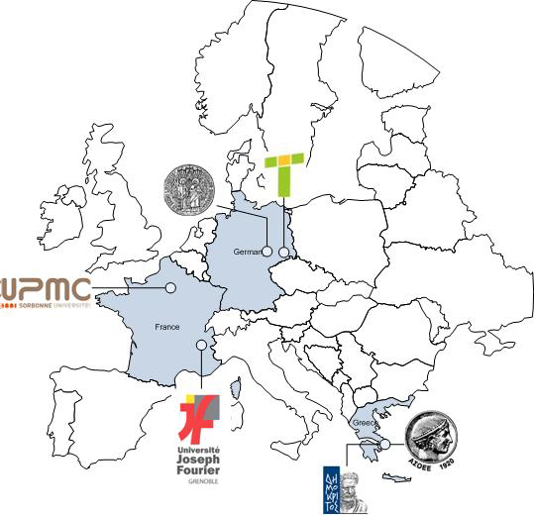

Slide 9
Contact
George Tsatsaronis george.tsatsaronis@biotec.tu-dresden.de
bioasq.org

Slide 10
The Schedule and the Prizes
Evaluation infrastructure & dry-run data
Start of the challenge
End of the challenge
BioASQ workshop
2013 Schedule
March 2013 June 2013 August 2013 September 2013
Evaluation infrastructure & dry-run data
Start of the challenge
End of the challenge
BioASQ workshop
2014 Schedule
March 2014 June 2014 August 2014 September 2014
You can join in any batch of both tasks!
Partial submissions are also allowed, e.g., answering only few of the questions.
Prizes for Task a
1st place system of a batch receives 550€
2nd place system of a batch receives 275€
Prizes for Task b
1st place system of a phase (A or B) receives 1600€
2nd place system of a phase (A or B) receives 900€
e.g., if a system wins both phases, it will receive 3200€
A special award will be given to the overall best contribution (sponsored by Transinsight GmbH)

